Slide 1
Introduction to Spatial Data Science and Machine Learning Urban Design B-Pro 2022/2023 Liam Thomas Bolton PhD Architectural Space and Computation student and PGTA

Slide 2
Overview
The aim of these workshops is to provide an introduction to spatial data science and machine learning with Python.
Workshop participants will gain skills in:
Python programming for spatial data science
Spatial data, formatting
Data visualisation and mapping
Machine learning

Slide 3
Workshop Resources
The latest workshop material – including presentation slides, data and notebooks – can be downloaded or cloned from Github:
https://github.com/lbuk/UD_Intro_SDSML2022

Slide 4
Schedule
01. Spatial Data - November 11th 2022
Spatial data
Basics of programming for spatial data science with Python
Reading and writing spatial data
Data formatting
02. Visualisation - November 18th 2022
03. Modelling - November 25th 2022
04. Advanced - December 2nd 2022

Slide 5
What is Spatial Data Science? Spatial data science is subset of data science that focuses on the analysis, modelling and visualisation of spatial data. These workshops will cover introductions to spatial data, data visualisation and modelling including machine learning.

Slide 6
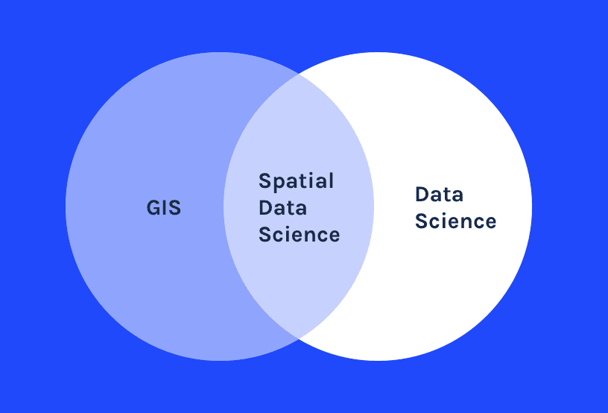
Carto, https://carto.com/what-is-spatial-data-science/

Slide 7
What is Machine Learning? Machine learning algorithms learn and make predictions from data. In subsequent workshop sessions, you will learn how to build machine learning models with Python and spatial data.

Slide 8
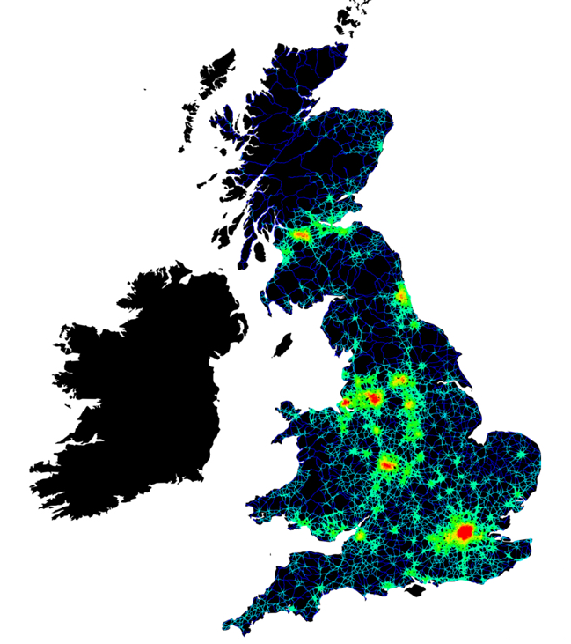
Spatial data science and machine learning have many applications in urban design and architecture
Spatial Data Science
Space Syntax, https://www.spacesyntax.online

Slide 9
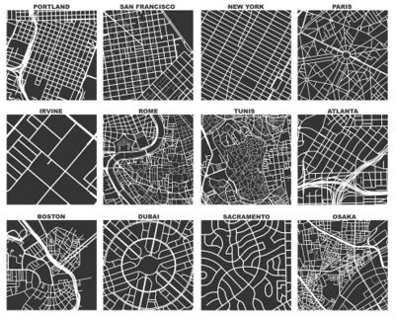
Spatial Data Science
OSMnx, https://wiki.openstreetmap.org/wiki/OSMnx

Slide 10
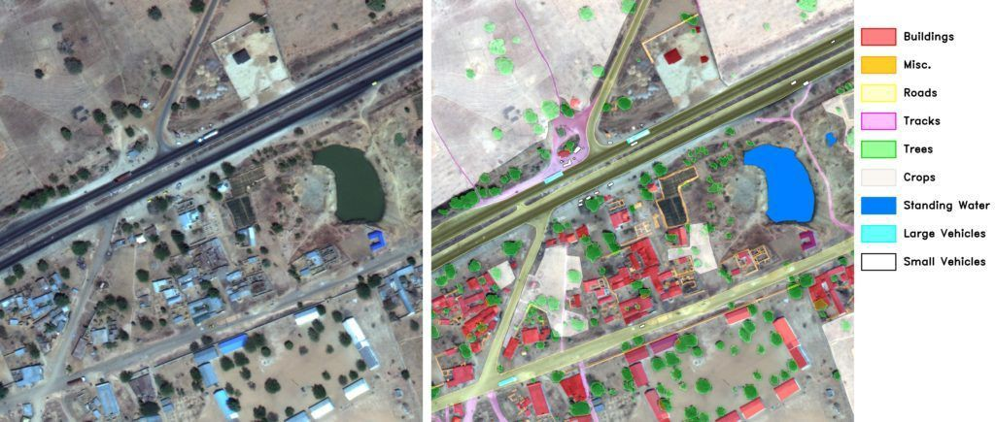
Machine Learning
Rayan Potter, https://medium.com/nerd-for-tech/what-are-the-ai-applications-for-satellite-imagery-in-machine-learning-3495b2abe514

Slide 11

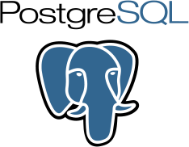



Software and Tools for Spatial Data Science Computational skills are essential to many aspects of spatial data science and machine learning as well as urban design. A range of software tools for performing spatial data science and machine learning exist.

Slide 12
01. Spatial Data 01_spatial_data - data - notebook

Slide 13
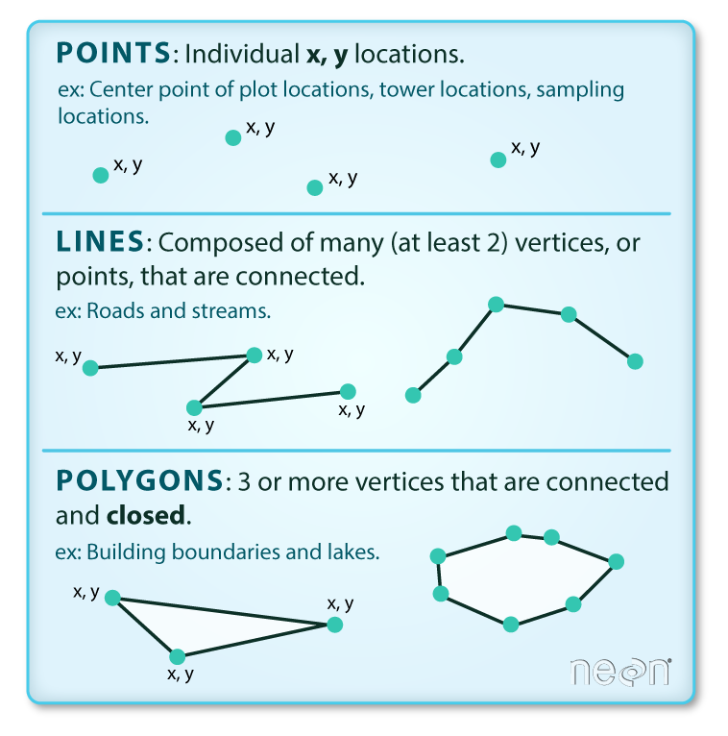
Vector Data
Points, lines and polygons.
Earth Lab, https://www.earthdatascience.org/courses/use-data-open-source-python/intro-vector-data-python/spatial-data-vector-shapefiles/

Slide 14
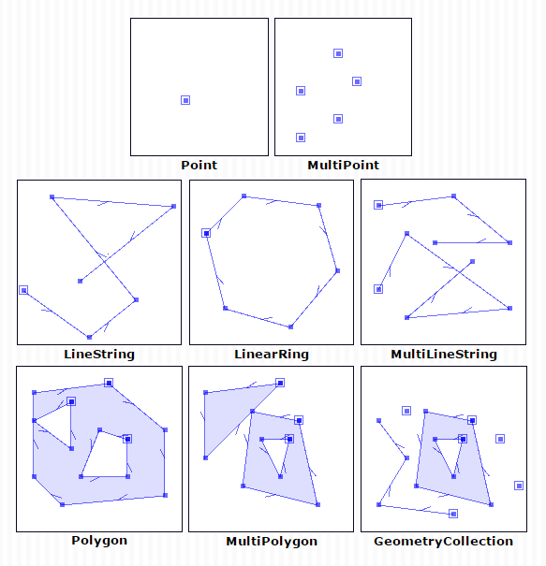
Geometry
Simple Features:
Point
MultiPoint
LineString
MultiLineString
Polygon
MultiPolygon
Geometry Collection
University of Tartu, https://kodu.ut.ee/~kmoch/geopython2021/L1/Geometric-Objects.html

Slide 15
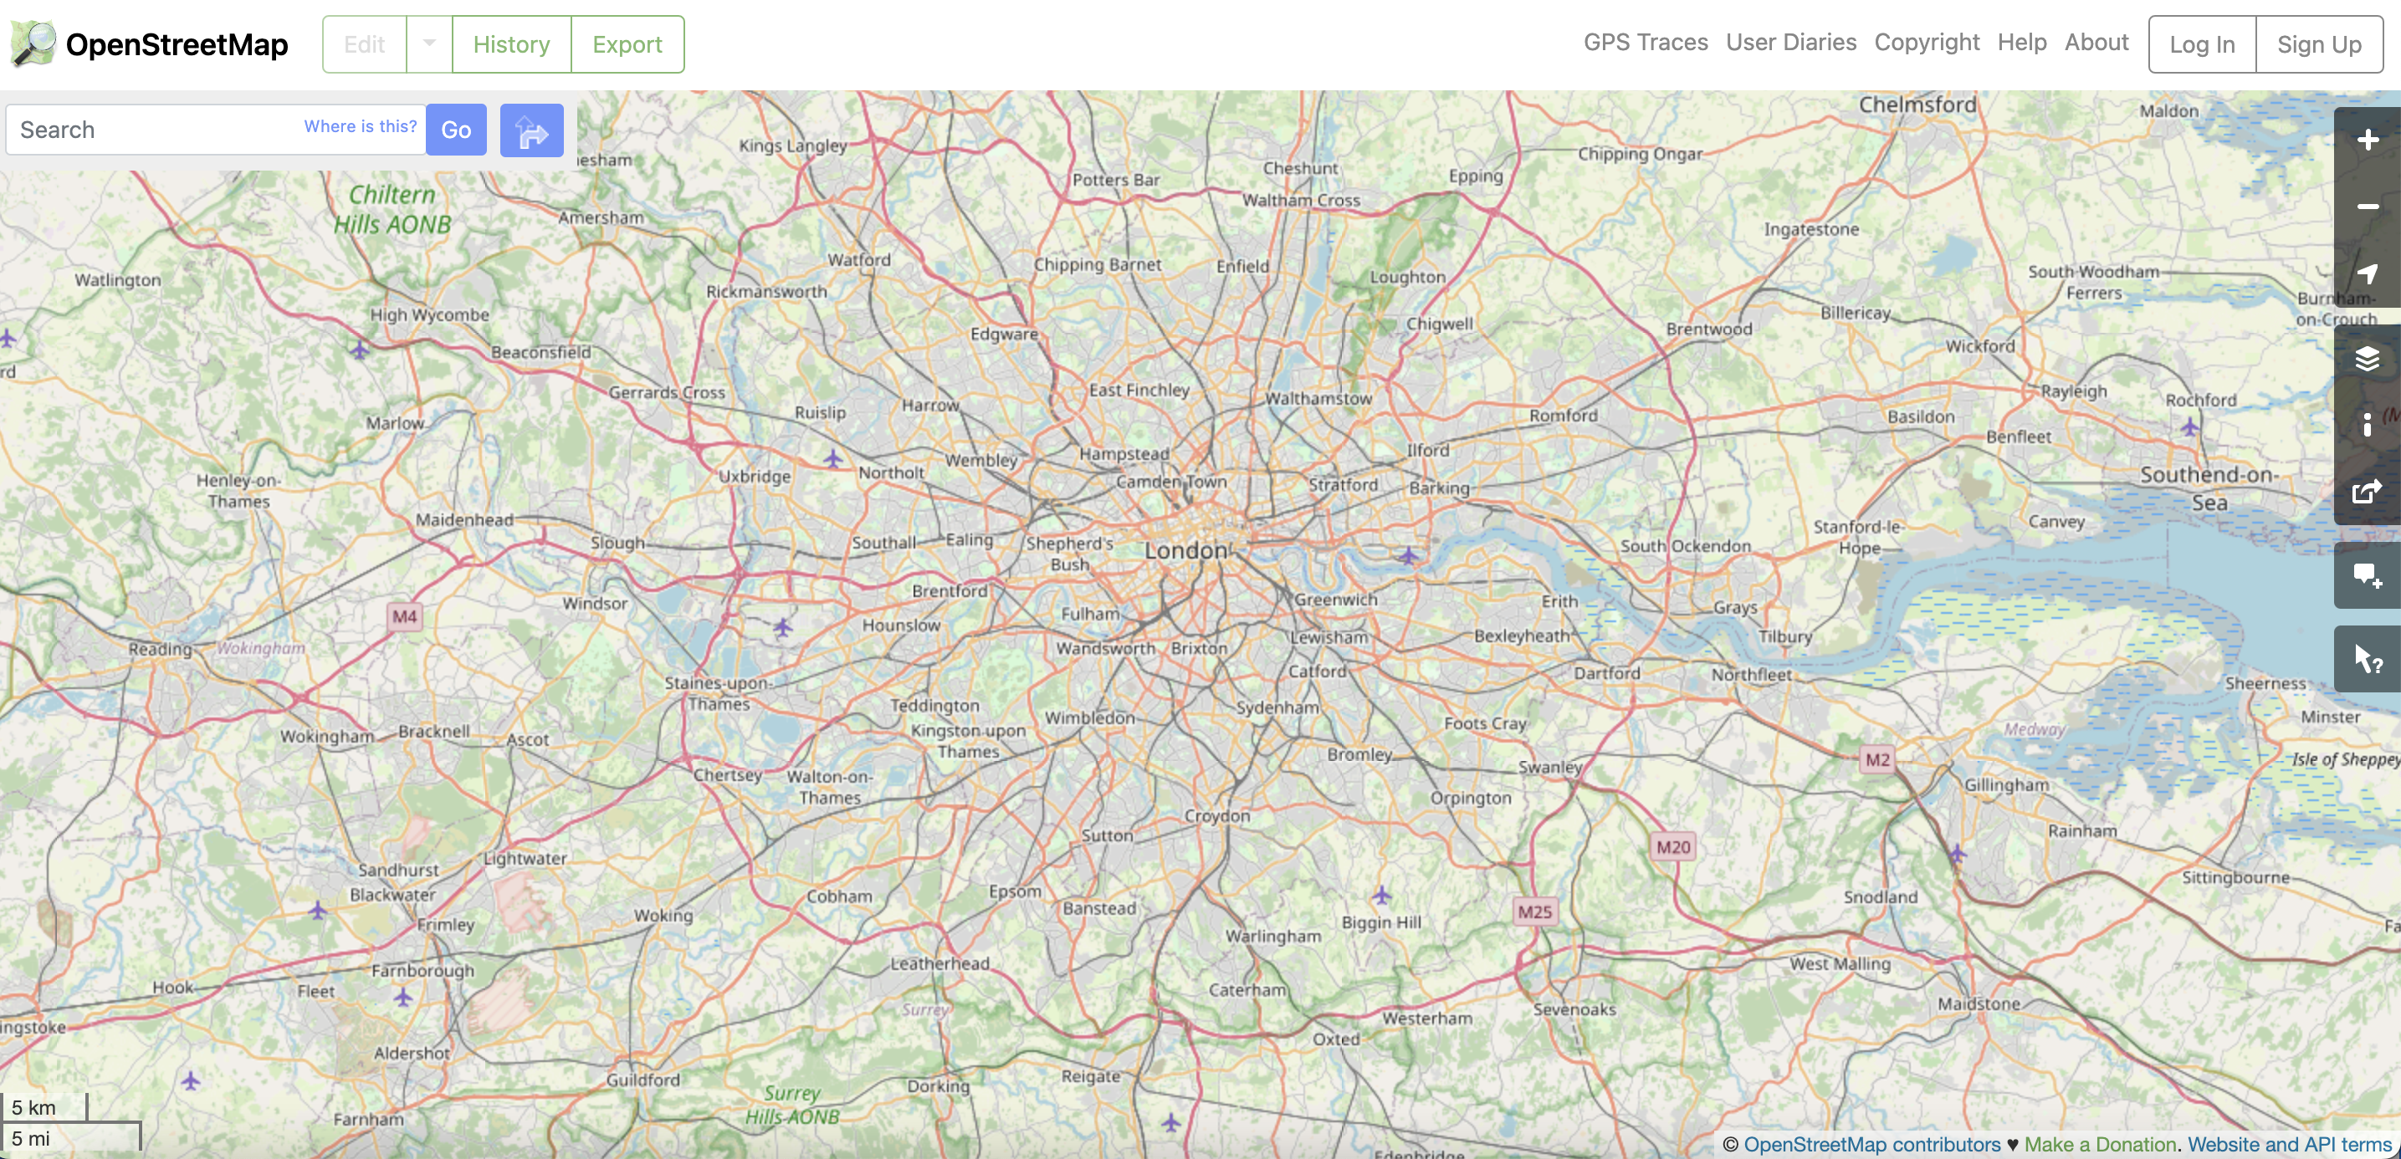
OpenStreetMap
A database of crowdsourced spatial data
OpenStreetMap, https://www.openstreetmap.org/

Slide 16
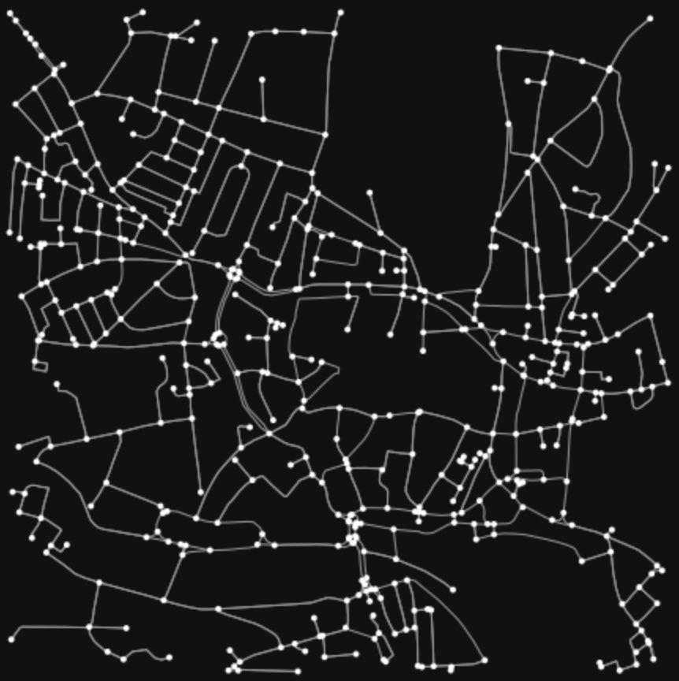
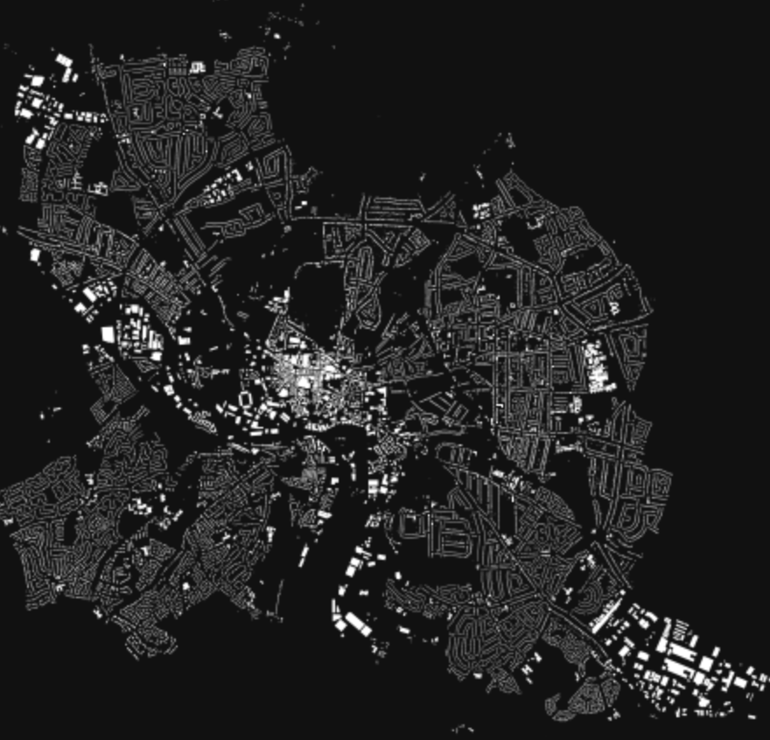
OSMnx
A Python package for analysing OpenStreetMap data
OSMnx, https://github.com/gboeing/osmnx

Slide 17
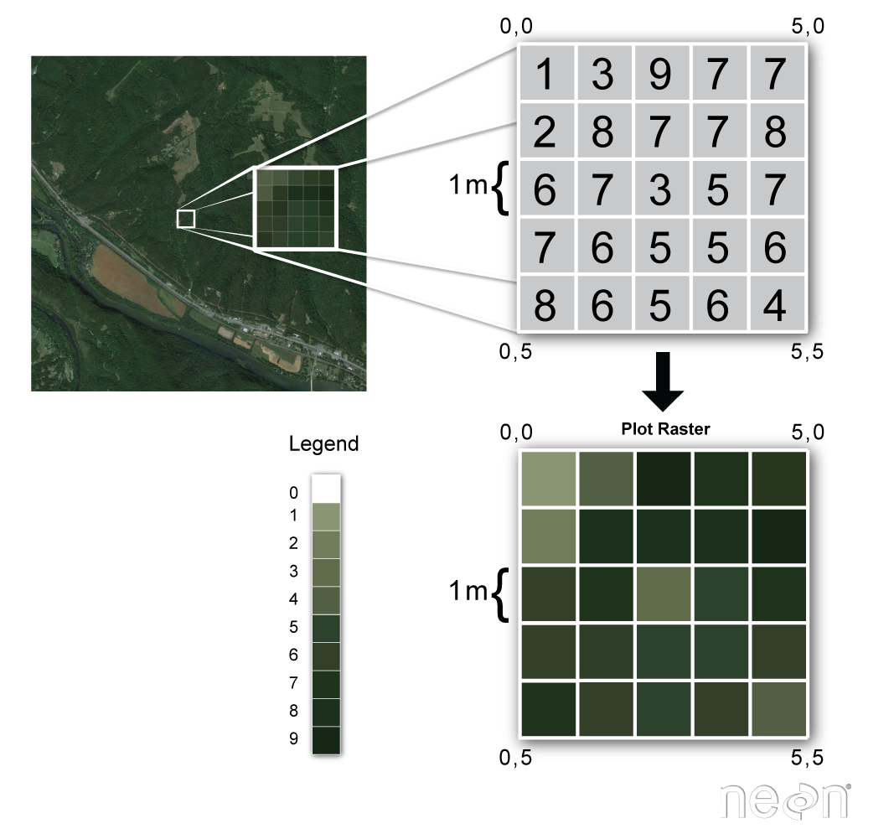
Raster Data
Represented by continuous surfaces.
Surfaces are composed of grids with cells.
Data Carpentry, https://datacarpentry.org/organization-geospatial/01-intro-raster-data/

Slide 18
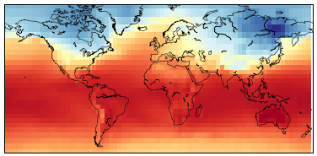
Raster Data
Utilised to represent environmental data such as elevation as well as socio-economic data such as population density.
IBM, https://developer.ibm.com/learningpaths/data-analysis-using-python/working-with-geospatial-raster-data-in-python/

Slide 19
Spatial Data Formats
A list of some of the most utilised spatial data formats:
Shapefile (.shp)
GeoJSON (.geojson)
GeoPackage (.gpkg)
Geography Markup Language (.gml)
GeoTIFF (.tif)
File Geodatabase (.gdb)
Vector data
Raster data
Vector data / raster data

Slide 20
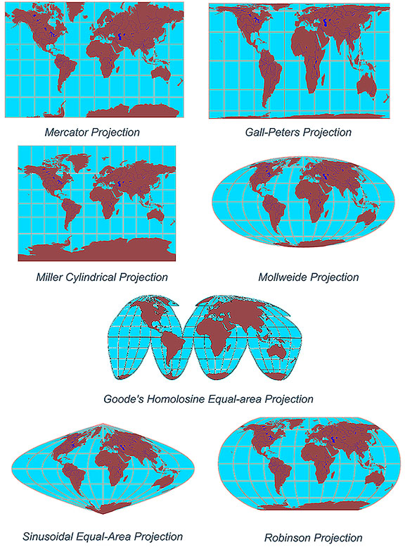
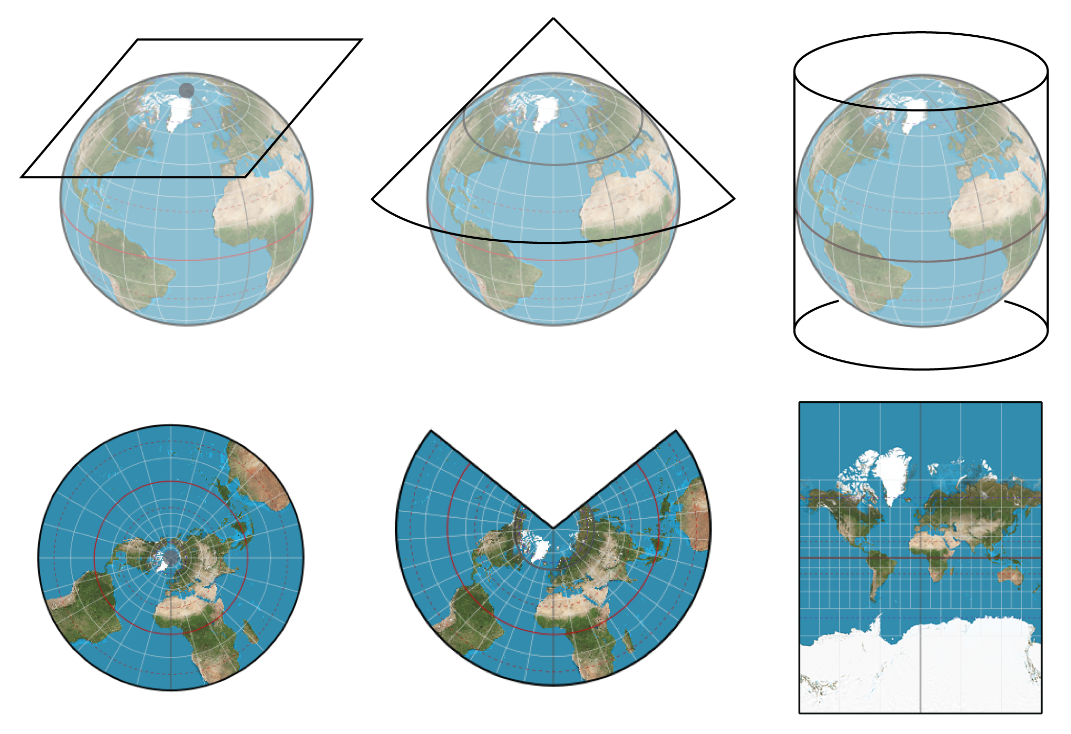
Coordinate Reference Systems
UCGIS, https://gistbok.ucgis.org/bok-topics/2018-quarter-02/map-projections
geoawesomness, https://geoawesomeness.com/map-distortions/

Slide 21

Programming for Spatial Data Science with Python This workshop focuses on Python, a programming language often utilised in data science, spatial analysis and machine learning. Python packages for performing spatial data science and machine learning include, but are not limited to: - GeoPandas - Matplotlib - LiDAR - GDAL - Shapely - Folium - scikit-learn
https://www.python.org/

Slide 22



https://gdal.org/
A package for working with vector and raster formats via the Geospatial Data Abstraction Library (GDAL)
https://geopandas.org
A Python package for working with spatial data
https://matplotlib.org/
A Python package for data visualisation and mapping

Slide 23
Python, Git and Jupyter Notebooks
If Jupyter is not already installed, download Anaconda (https://www.anaconda.com/) and install Jupyter Notebook or you can install it from the Terminal app with pip:
pip install notebook
Set the working directory from the Terminal app or in the Terminal in Jupyter Notebook.
Clone the latest version of the workshop repo from Github using Git:
git clone https://github.com/lbuk/UD_Intro_SDSML2022
Launch Jupyter Notebook:
jupyter notebook
Select the 01_spatial_data folder, the notebook folder and the 01_notebook.ipynb file

Slide 24
Introduction to Spatial Data Science and Machine Learning materials: https://github.com/lbuk/UD_Intro_SDSML2022 Python site: http://www.python.org/ Matplotlib site: https://matplotlib.org/ Geopandas site: https://geopandas.org Scikit-learn site: https://scikit-learn.org/stable/ OSMnx Github repo: https://github.com/gboeing/osmnx Jupyter site: https://jupyter.org/ Geoprocessing with Python book: https://livebook.manning.com/book/geoprocessing-with-python Geographic Data Science with Python book: https://geographicdata.science/book/intro.html Python Foundation for Spatial Analysis: https://courses.spatialthoughts.com/python-foundation.html Introduction to Python for Geographic Data Analysis book: https://pythongis.org/
Resources

